Slide 1
Reception Open Evening
Thursday 27th June

Slide 2
Introduction
Teacher: Miss Davison
Teaching Assistant: Mrs Grisby
One afternoon a week the teacher will be released to plan, prepare and assess (PPA) outside of class. During this time, there will be a cover teacher in the classroom.

Slide 3
Drop off arrangements
KS1 green gates open at 8.40
Please wait outside the classroom doors until the door is open.
On the first day… when the children’s entry is staggered - please do enter with your child and support them to put their belongings on their peg. Please check your appointment time for the first day and arrive for that time.
After the first day… we encourage children to be independent by putting their own belongings away with the expectation of them coming into class independently.
We ask that your child does not bring in toys.

Slide 4
Pick up arrangements
Please enter the school through the KS1 green gates.
Collection time is 3.20pm from the classroom door.
We send children to you when we can see you so we are sure they have gone home with the correct person.
Children going to Latchmere After School Club are collected and taken there at 3.10pm.

Slide 5
Notice board and message book
Please do let us know in advance if a different person (over the age of 16) is going to be collecting your child - there is a message book on the class noticeboard or you can email.
If you know you are happy for different family members or other pupils’ families to collect your child and this is a permanent arrangement, please let us know of all those people in writing.
Please email clubs@latchmereschool.org or go through the office if your ASC arrangements change.
If you need to drop your child off late or pick them up early, please write an email to the office.

Slide 6
Discussions about your child
Generally, class teachers are available until around 8.50am if you have a quick query about your child and can be spoken to at the classroom door.
If you would like a more detailed conversation, please arrange a time after school.

Slide 7
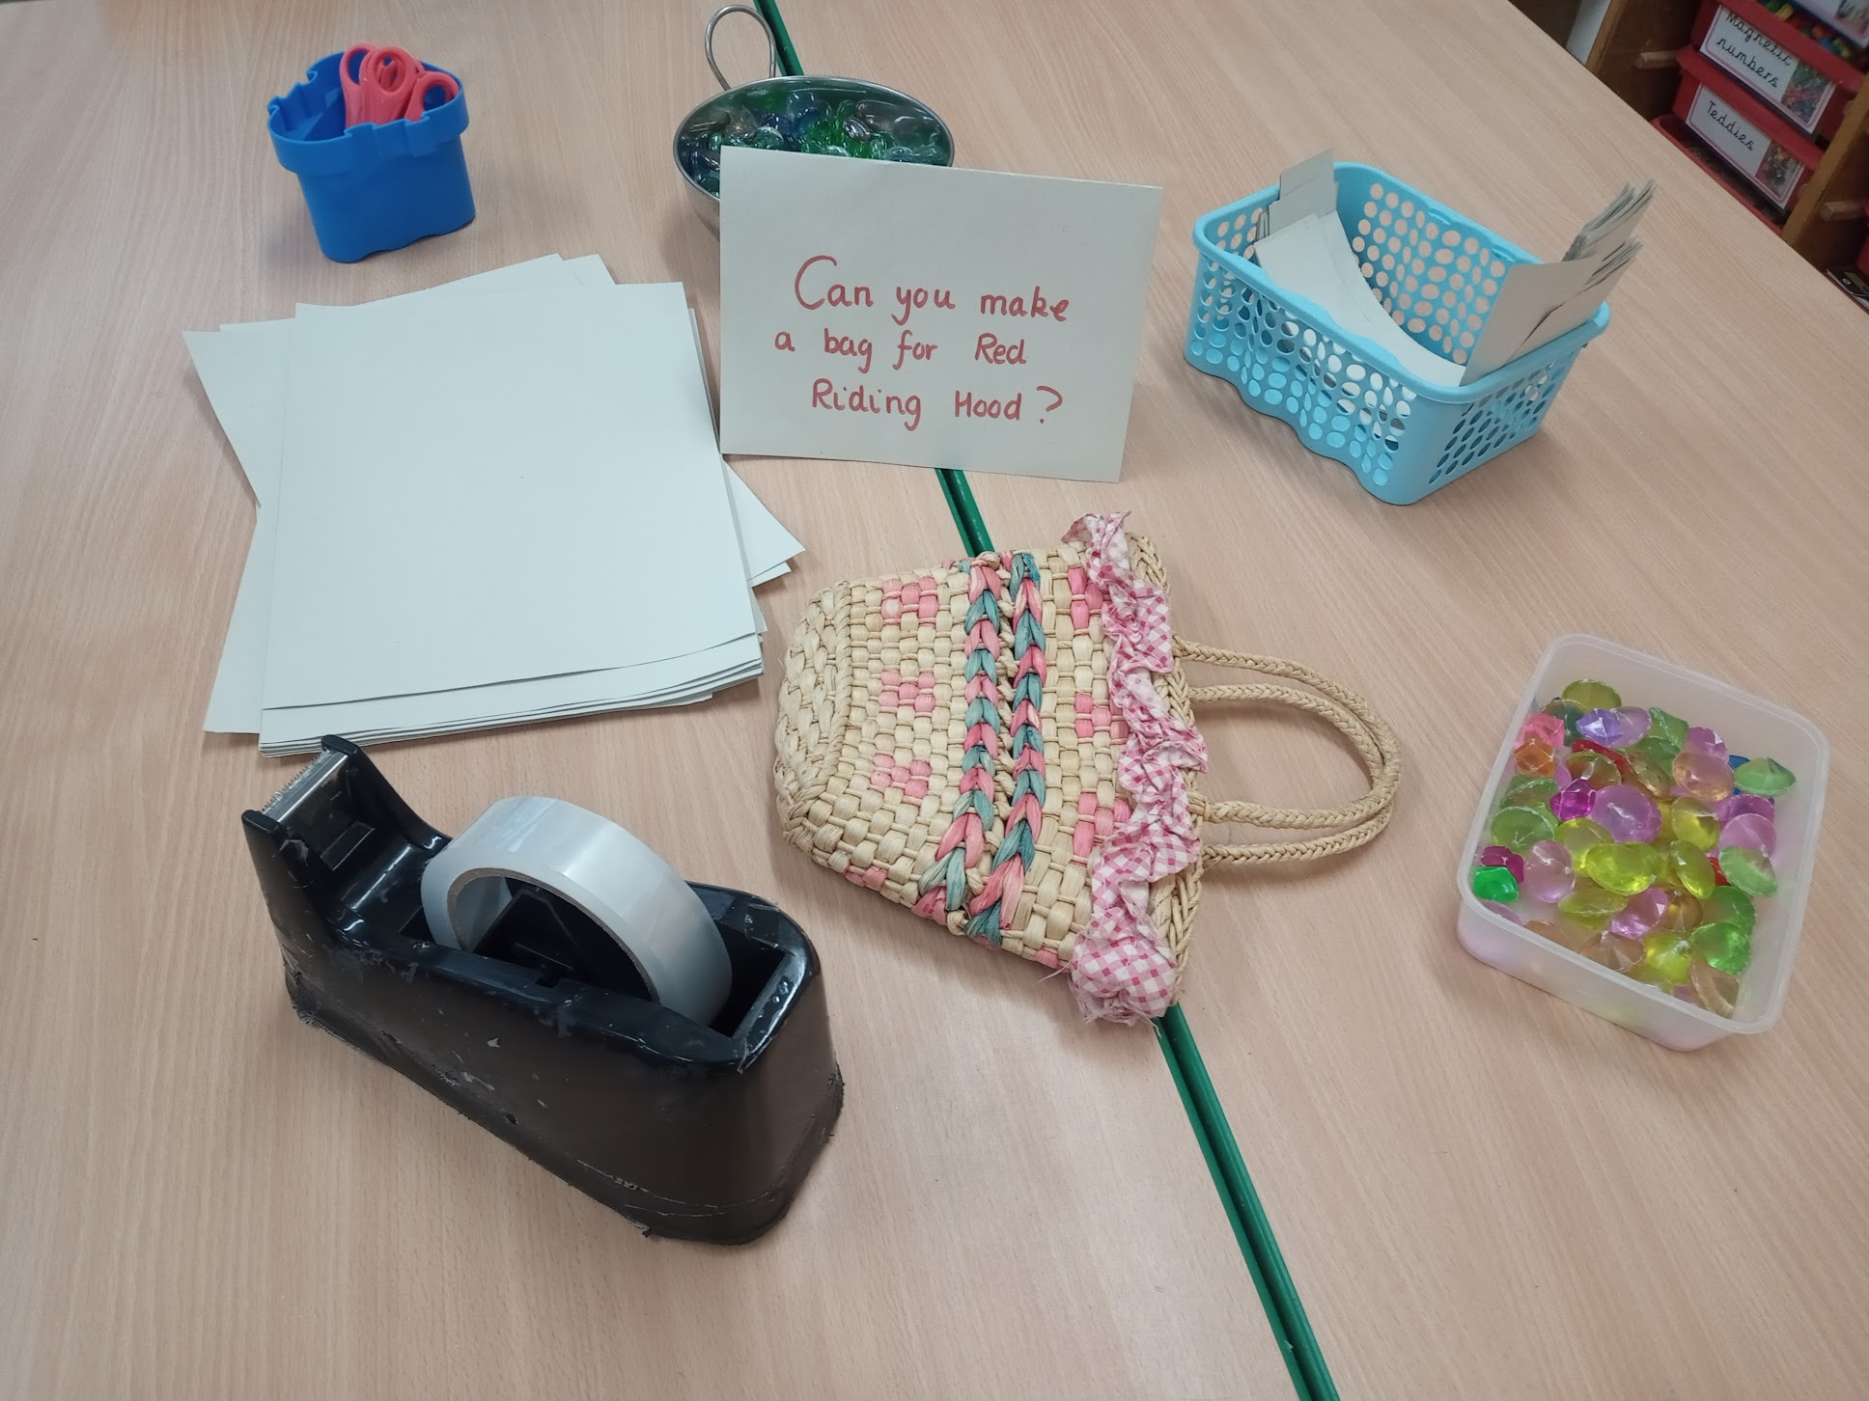
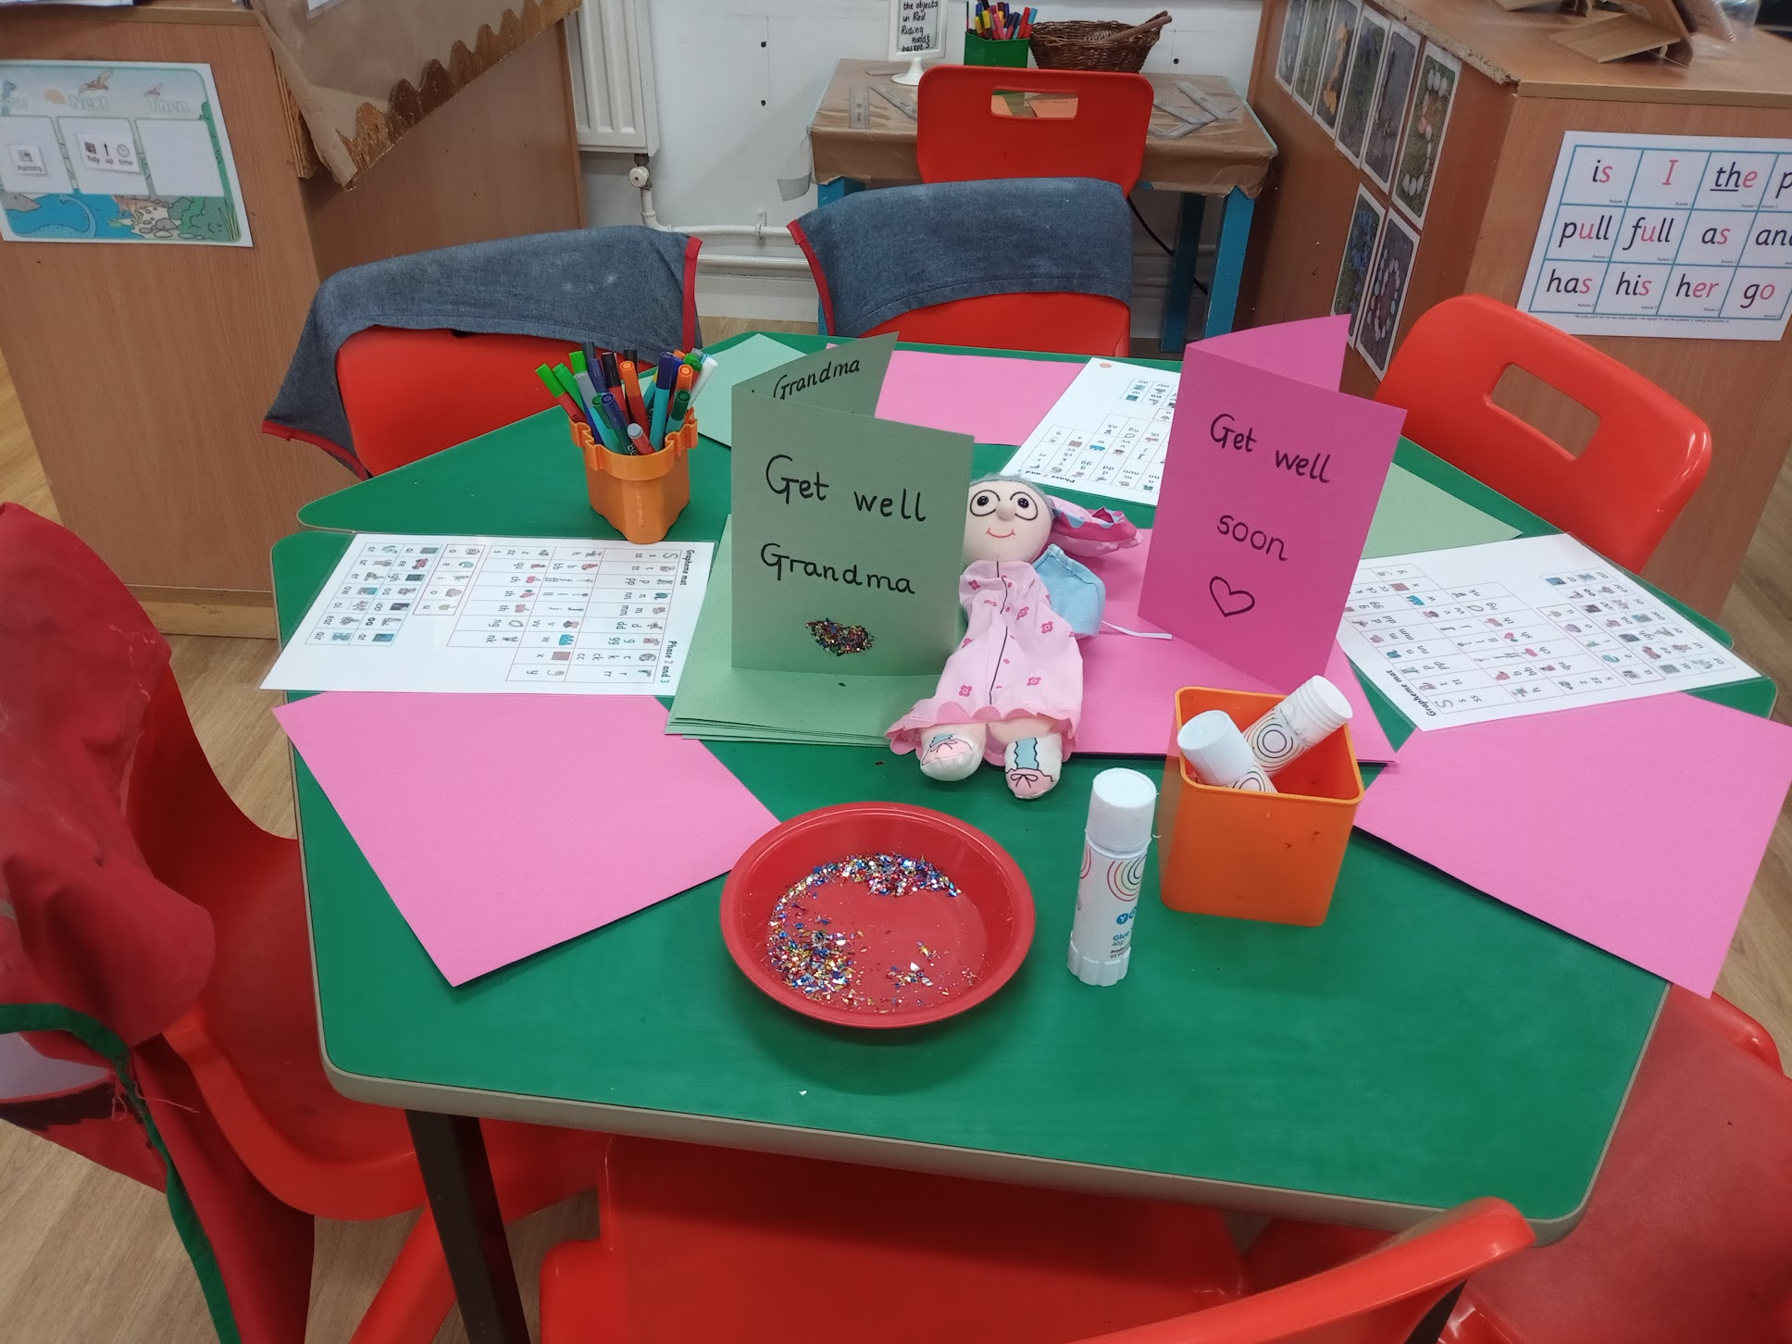
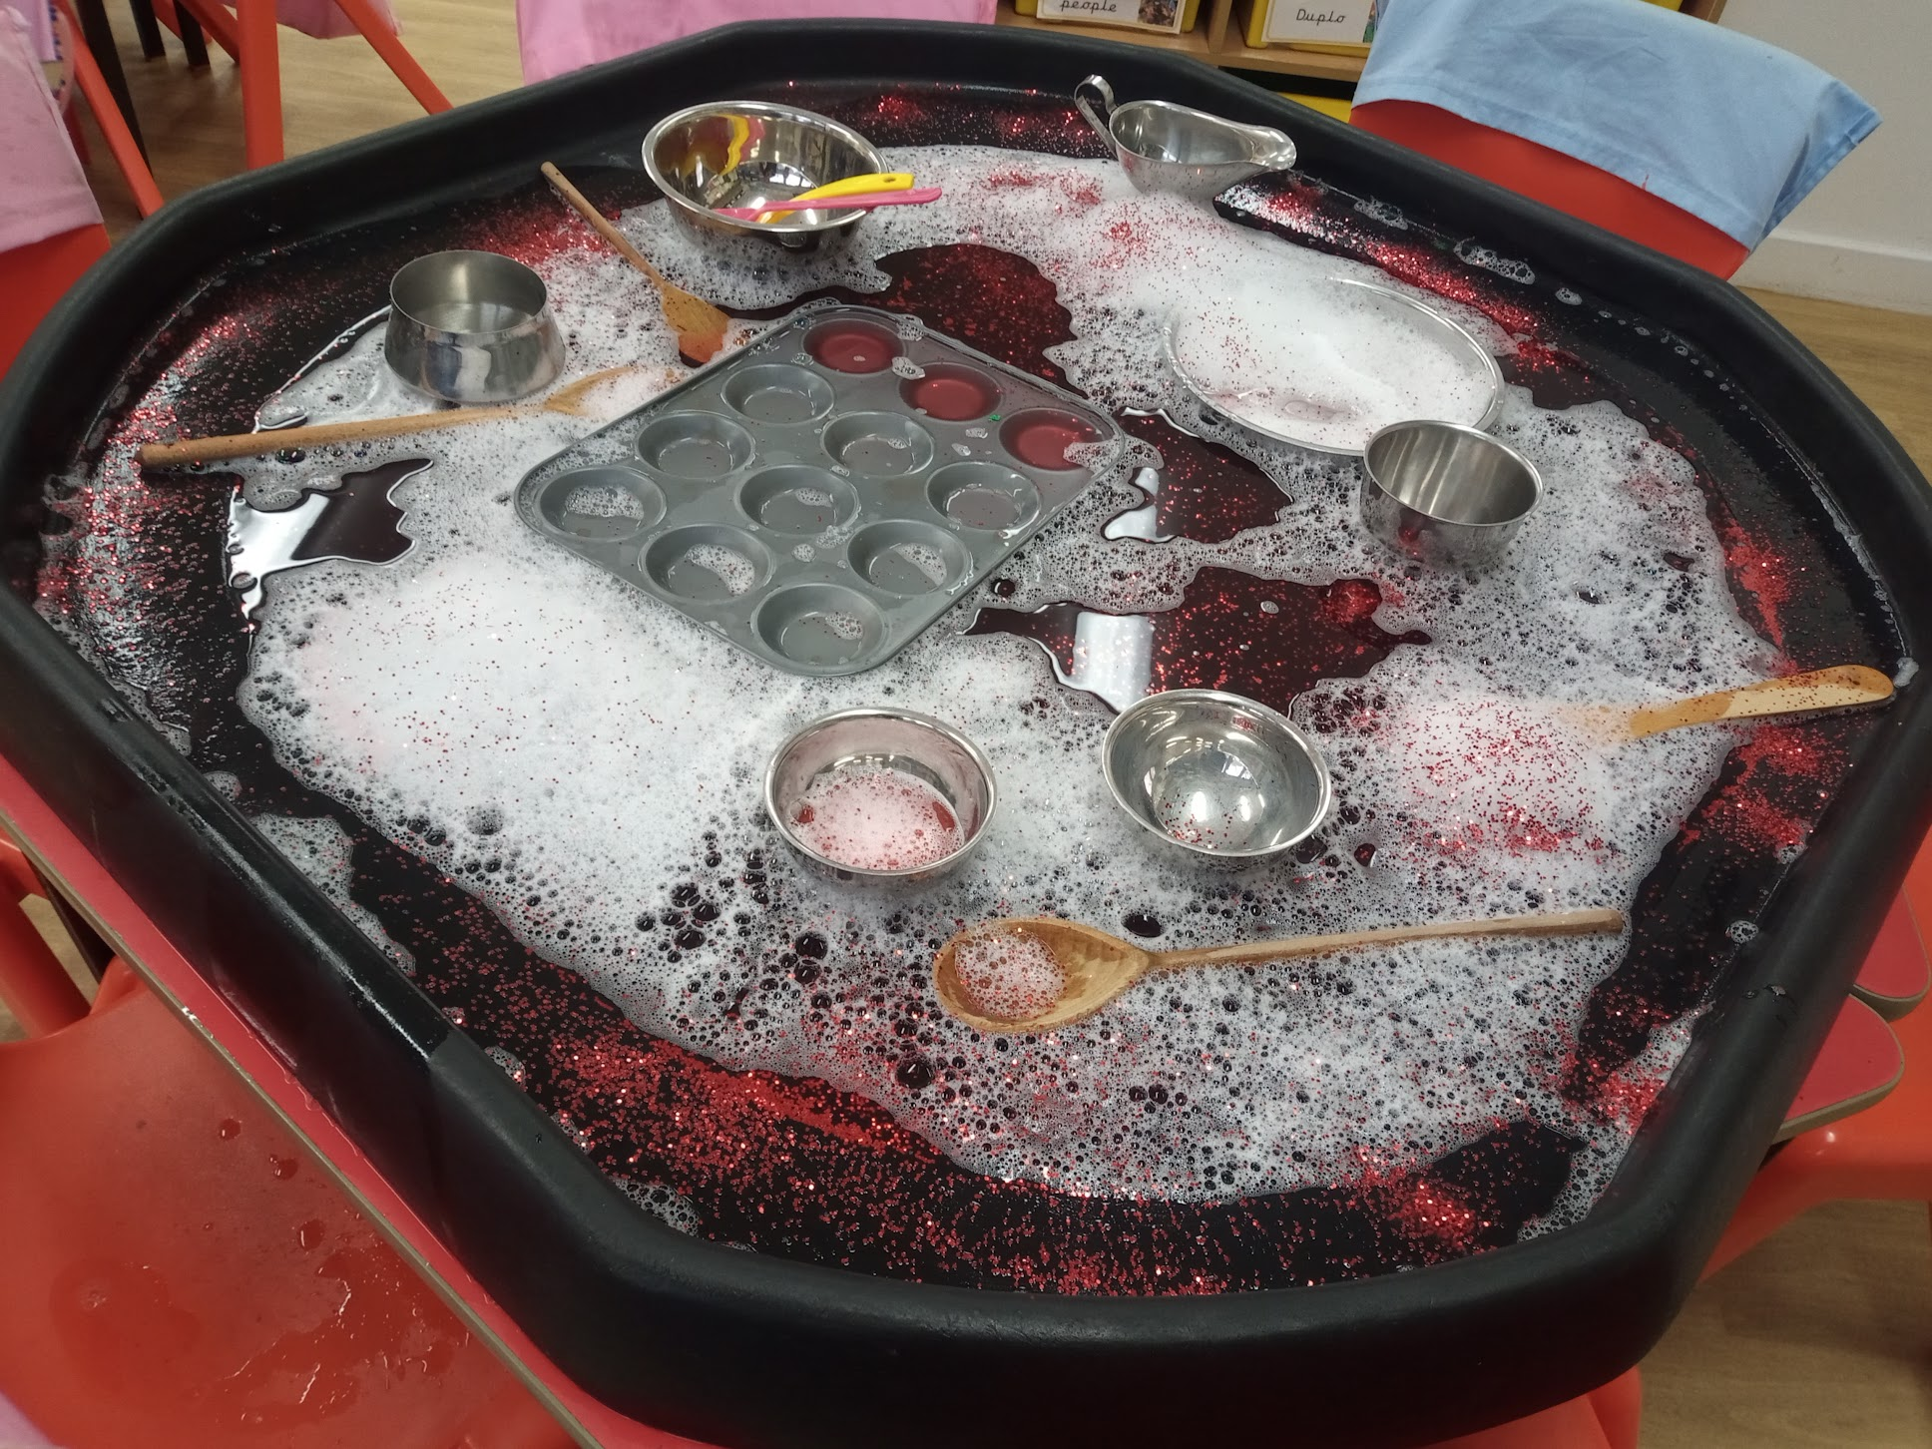
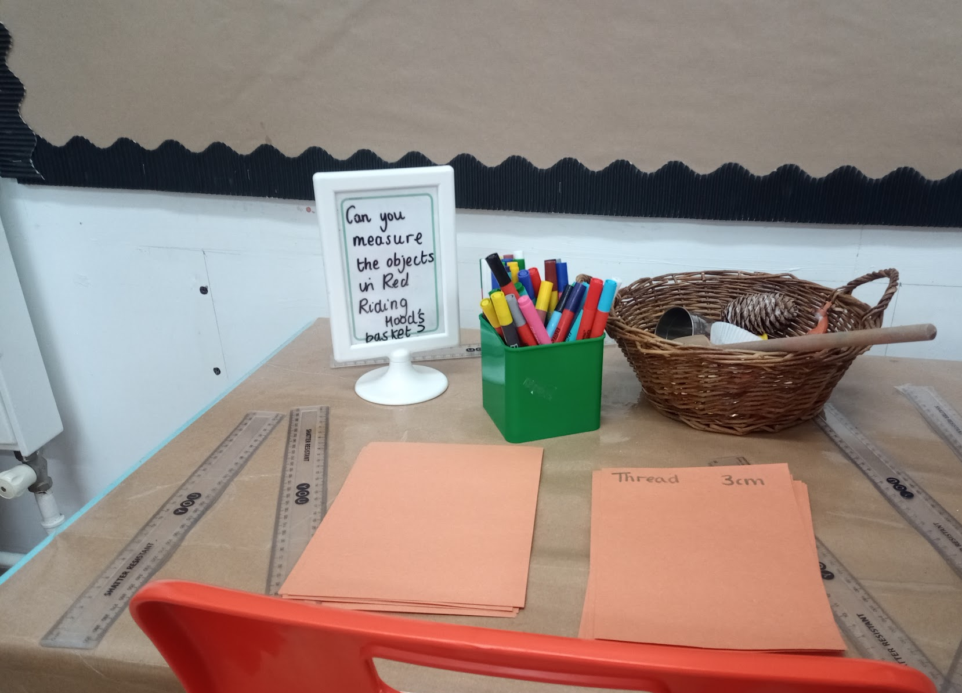
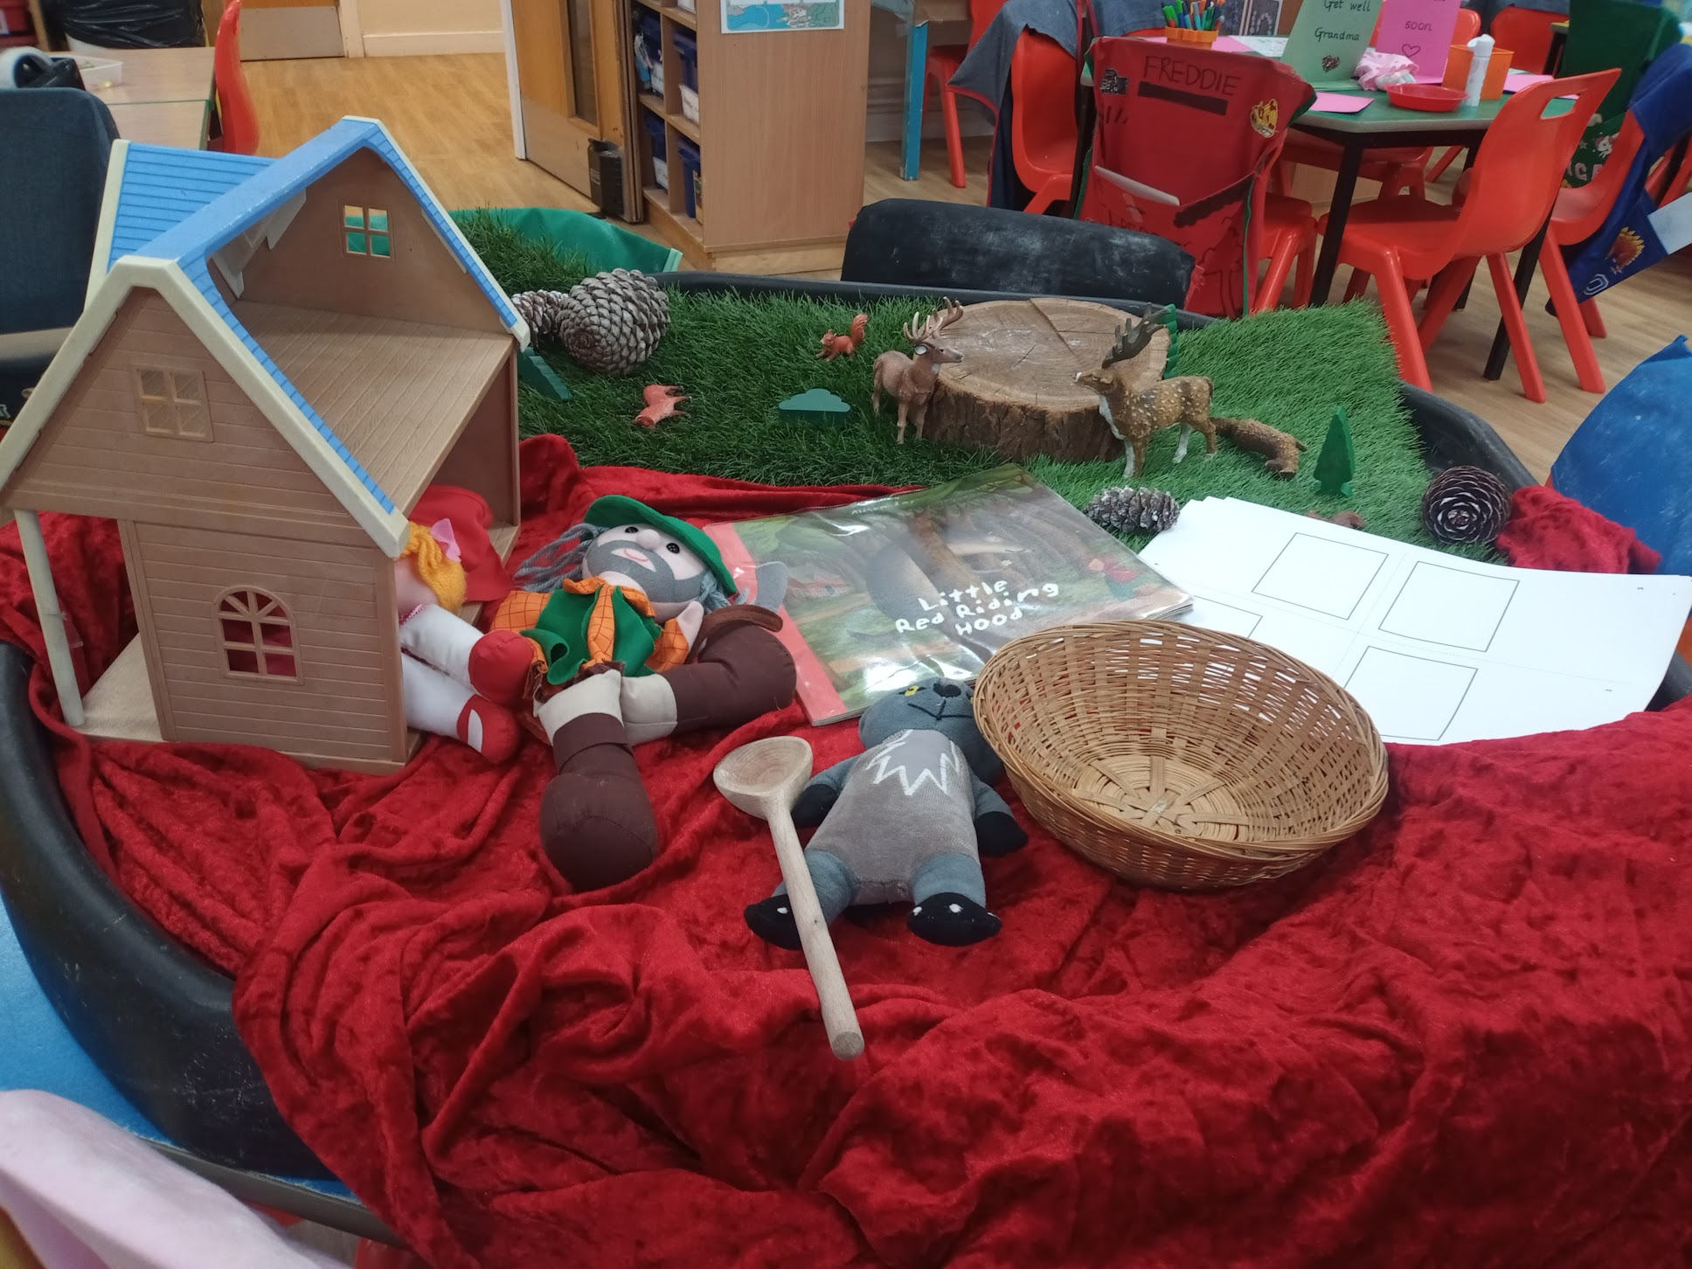
Classroom Layout
Classroom is divided into areas: writing, maths, role-play, ‘making’, creative area.
Children are able to move around freely between activities unless there is a specific focus activity, which is adult-led.
The outside area is an extension of the learning in the classroom.

Slide 8
Learning
Children will be invited to bring in topic related items to contribute to displays and the role play area.
Learning Journeys - these document your child’s progress and journey through Reception.
We will set half termly challenges for your child to complete linked to our learning. Please work on these together at home.

Slide 9
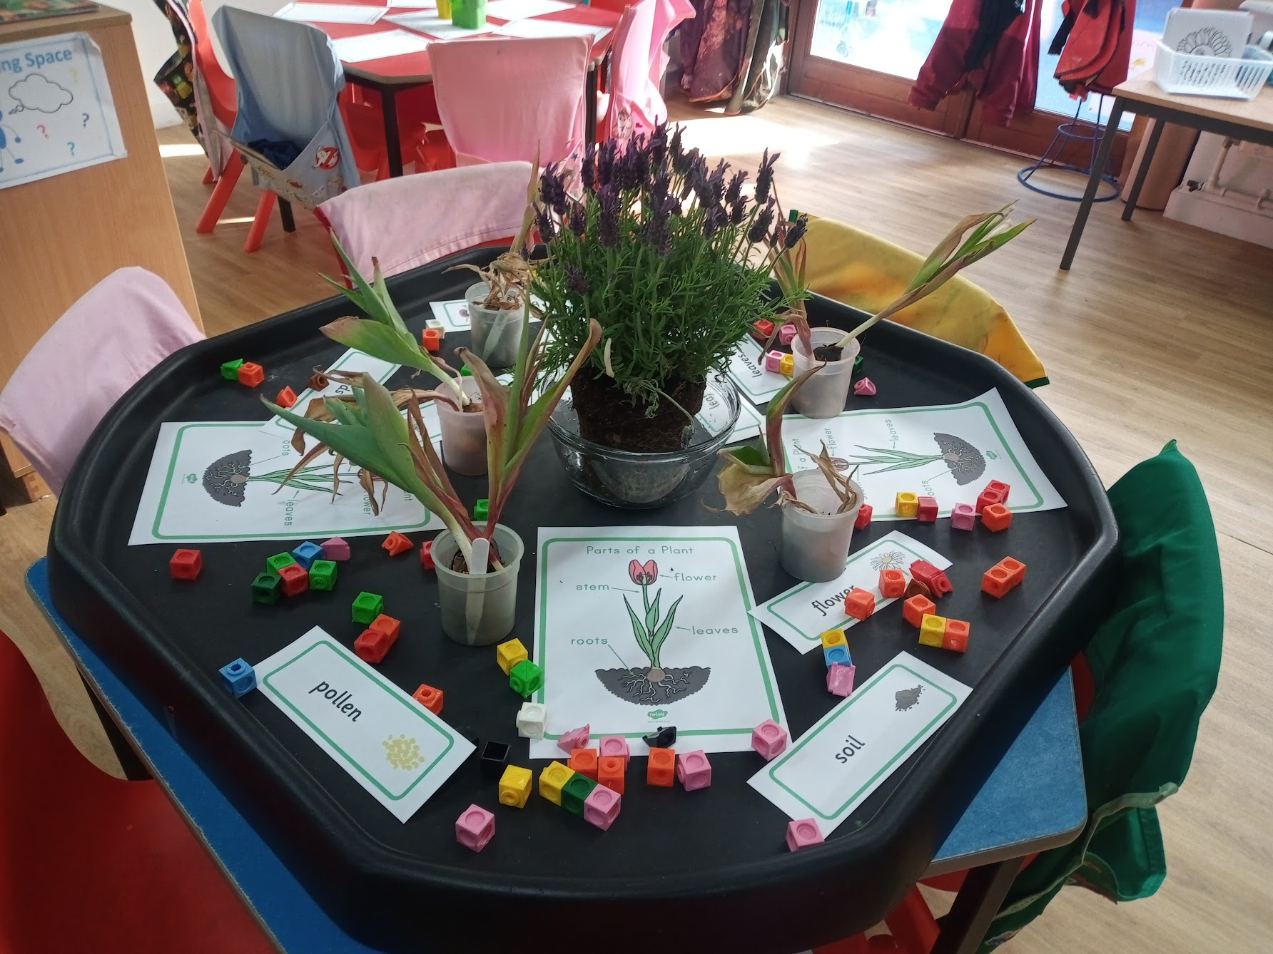
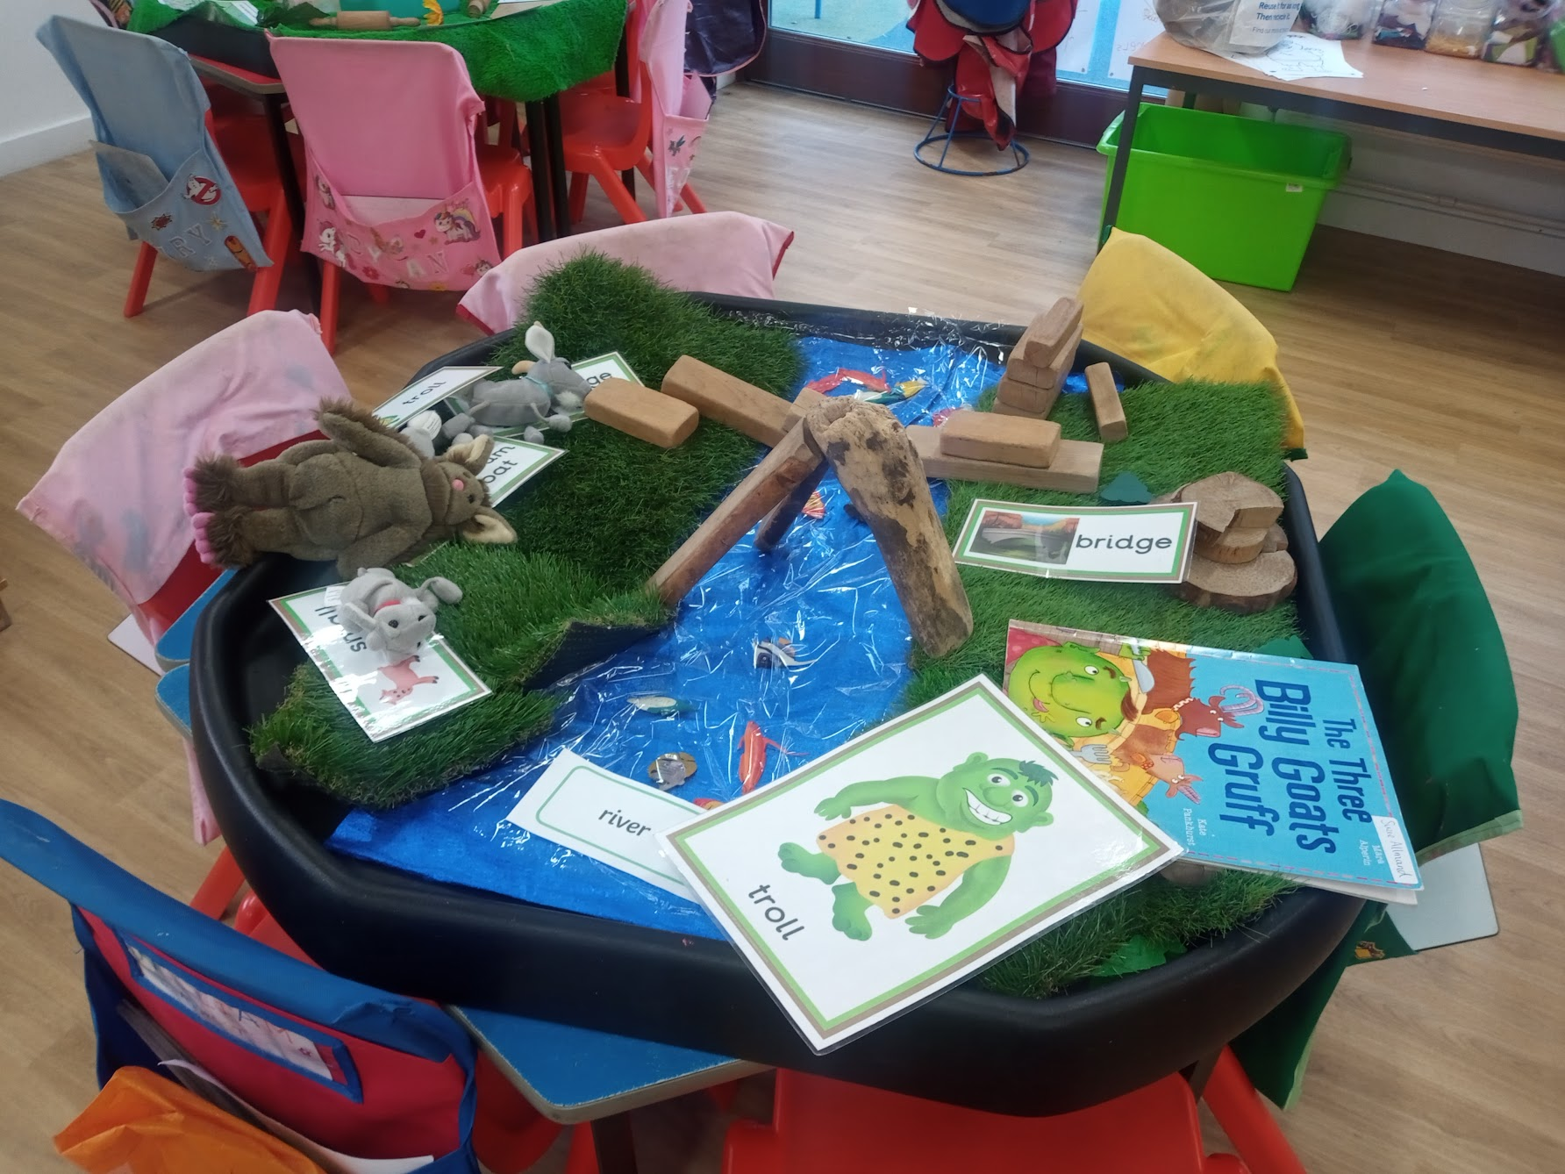
Reception Curriculum
Three ‘prime’ areas: personal, social and emotional development; communication and language; physical development.
Four specific areas: literacy; mathematics; understanding the world; expressive arts and design.
Different activities will be in the classroom to facilitate the learning of these areas.
Learning happens through structured play - a balance of child-initiated and teacher-led activities.

Slide 10
Lunchtime arrangements
All children are offered a free school meal (a ‘hot’ lunch) in Innovation House.
If you prefer for your child not to have this, they can bring in a packed lunch.
Children will be with the class teacher in Innovation House and will be looked after by teaching assistants during lunch play.

Slide 11
Reading Record
When your child brings home their first reading book (this will depend on your child’s journey with phonics), they will bring home a Reading Record.
This will show you our focus for the reading session. We read three times a week.
It might mention any sounds or words your child is finding tricky.
You will have space to write a weekly comment, letting us know what you have enjoyed at home together and any successes or challenges your child is having with their ‘Reading Practice’ book.
We would be grateful if this could come in every day, as they are regularly used.
Please send the Reading Record and Reading Practice books in the Latchmere blue book bag, not a rucksack due to space.
More information to follow in the autumn term…

Slide 12
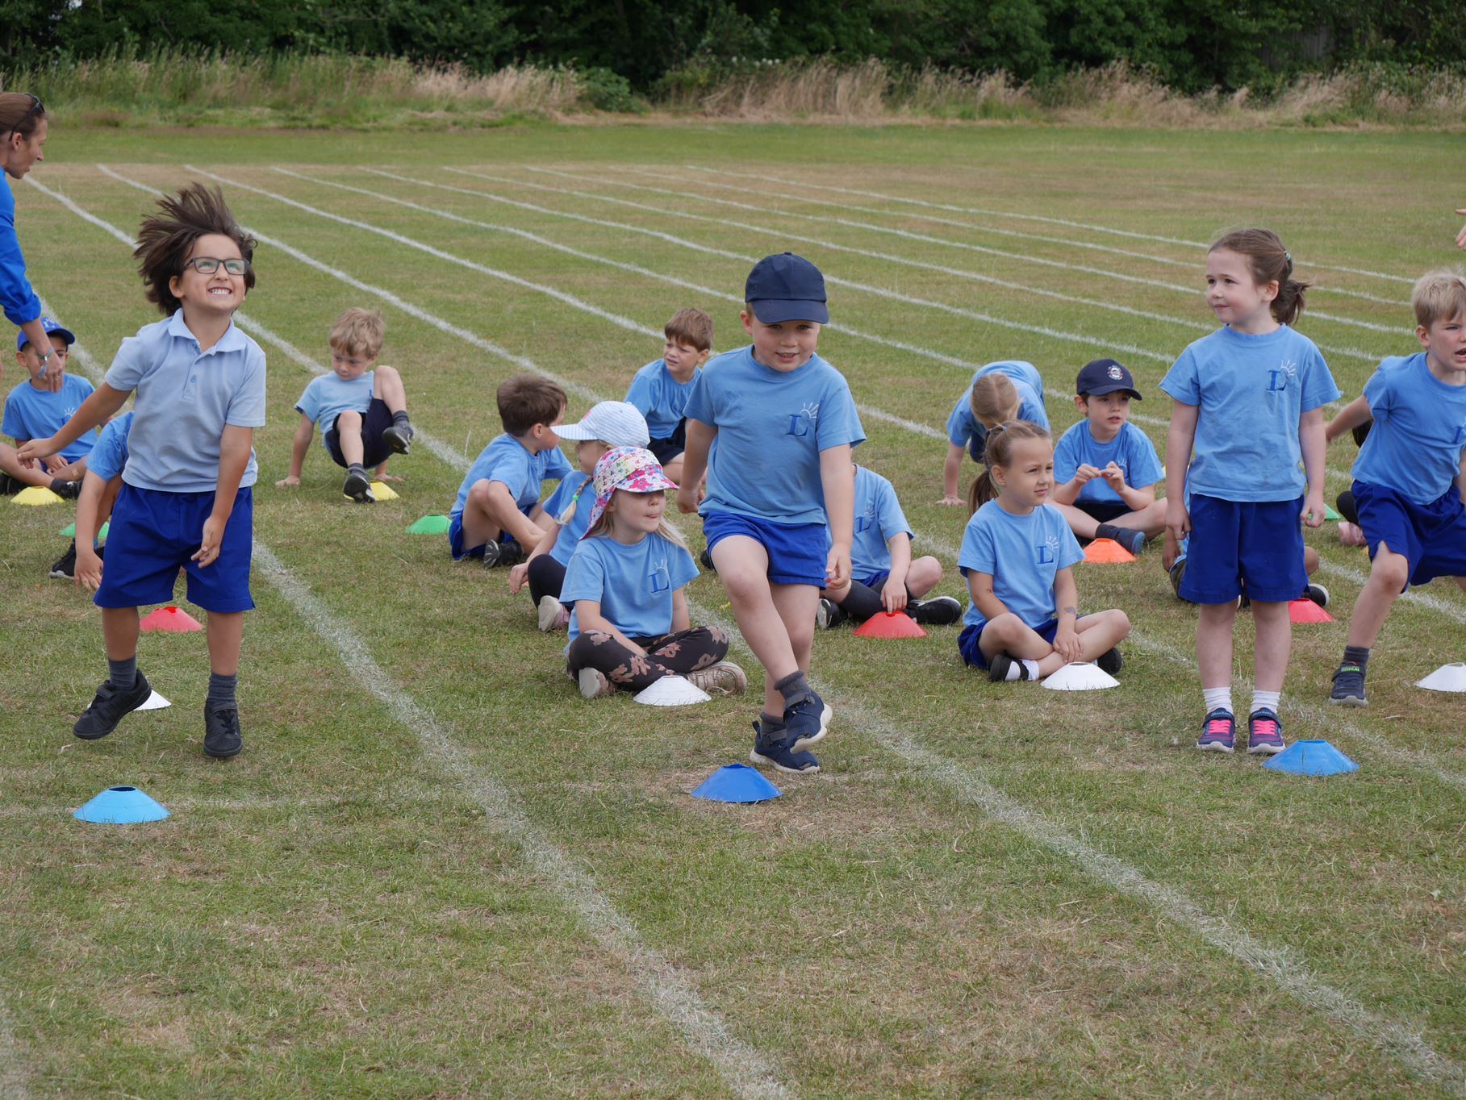
P.E
Latchmere (or blue) t-shirt, blue shorts, trainers.
Dark blue leggings/tracksuit bottoms in winter.
Come into school in P.E kit on their P.E day.
Class P.E day will be given in September.

Slide 13
Parent representatives
Each class has at least two parent reps, who kindly organise things throughout the year (cake sales, summer fair stalls, etc).
Provide a vital link between school and parents.
We will put up a list in September for those parents who may be interested in being a parent rep.
Names will be picked out of a hat if we have lots of interest.

Slide 14
Parent readers
Later in the autumn term…
Timetable on the class notice board with slots to sign up if you are available to help with reading.
Notes:
Michelle…

Slide 15
Birthdays
We celebrate children’s birthday in class!
Please give all party invitations outside the classroom to avoid any upset in class.
In keeping with our healthy eating policy, we do not share sweets or cakes in class on birthdays.
You are more than welcome to send in stickers, if you are able to provide for each child to have one, or we would love a book for the class!

Slide 16
Snack time
Mid-morning and mid-afternoon
Healthy school policy: fruit, vegetables, dried fruit or plain crackers.
Large fruit and vegetables preferably cut up and placed in a named pot
Please avoid putting the snack in the lunch box as it can be confusing - lunch or snack?
Fruit or vegetable snacks are available from school - however, there is a limited choice and they are not guaranteed (e.g. first day after a holiday).

Slide 17
Over the summer holidays…
Please help your child to become more independent - e.g. taking off their own jumper, putting on their own coat, being able to take their things out of their bags, opening their container if they will bring one for their snack etc.
When your child is colouring or using small tools, encourage them to use a tripod grip.
Please encourage your child to use a knife and fork correctly. This will help them to be more independent in the lunch hall.
Please name all your child’s belongings, particularly clothes they may take off like jumpers.
Notes:
A.B

Slide 18
Next…
You can meet:
Our Headteacher: Carolyn Coles
Our Deputy Headteacher: Claire Hogston
SENDCO: Hollie Sheehan
LSPA: Latchmere School Parent’s Association
Class visit morning: Thursday 4th July 9.15-10am SURNAME A-L and
10.15-11am SURNAME M-Z
Stay and Play (optional) will be on Wednesday 4th September – 12.45pm-1.30pm SURNAME A-L and 2-2.45pm SURNAME M-Z
Notes:
A.B

Slide 19
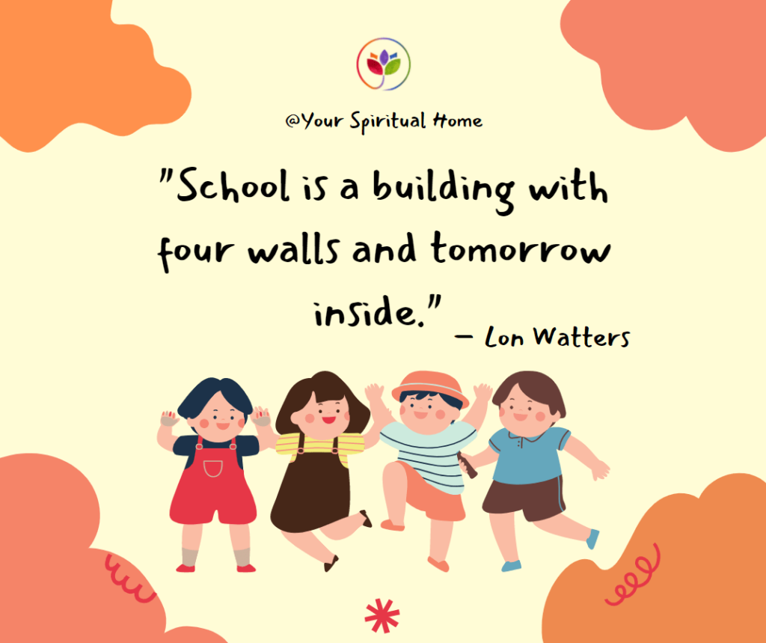
Any questions?

